Slide 1
Photo Gallery Web Application
Yifu Yang

Slide 2
User registration and verification
JSON object
Local session storage
Spring WebSecurity-BCryptPasswordEncoder

Slide 3
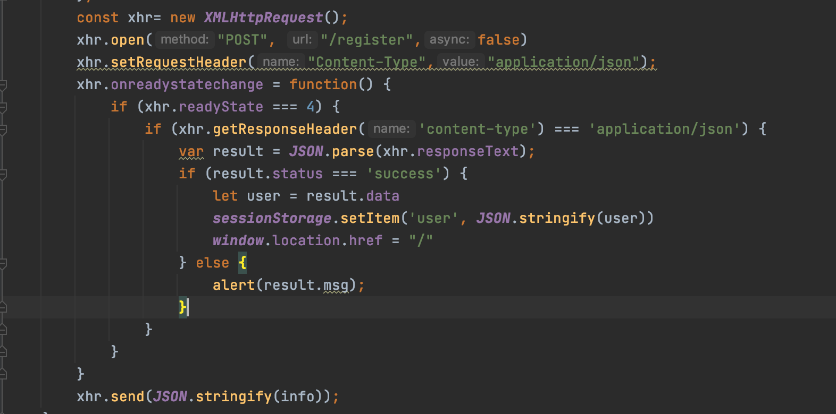
Post and receive JSON object
Use XMLHttpRequest to Post user info as a JSON object to controller to check if it is a valid registration or verification request, and receive a JSON contains status and data, or message back to front side. If the status equals to success, save the data into local session storage

Slide 4
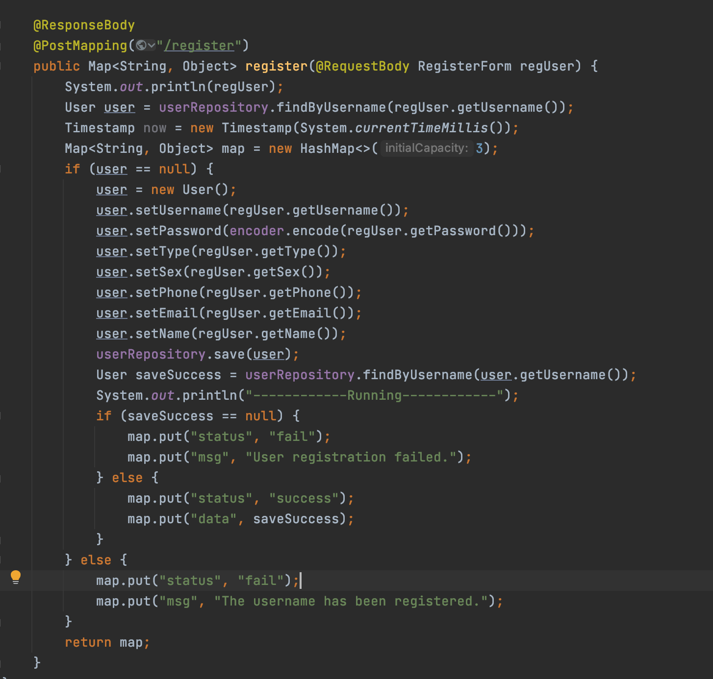
Controller design

Slide 5
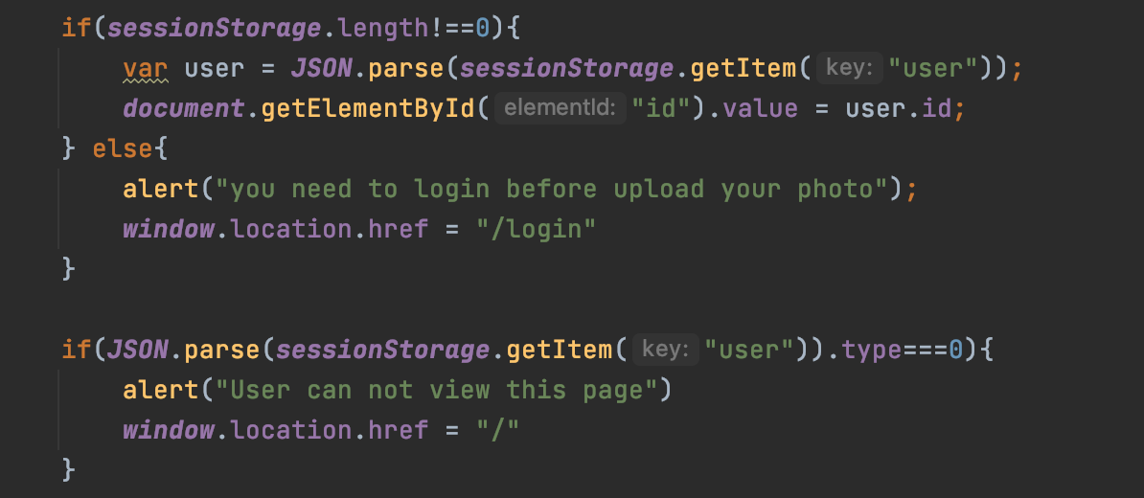
Use of session storage
Use onload function to determine whether there is a login user.(at front side instead of build a new table to check at back end)
Use onload function to determine if current user has permission to access current page.

Slide 6
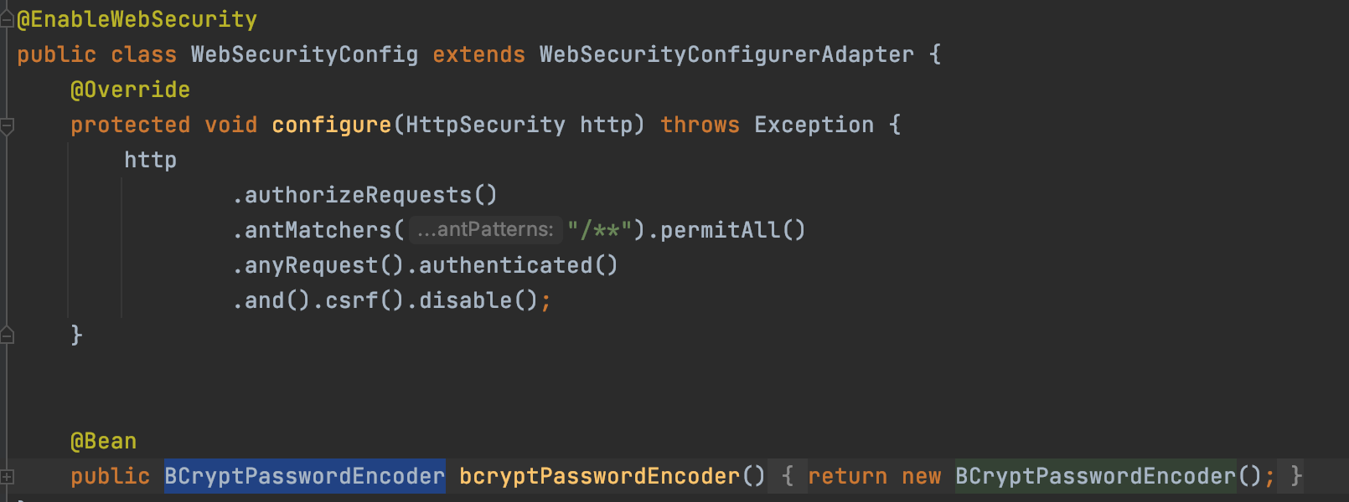
Use of BCryptPasswordEncoder
user data is stored inside the browser which means some of user info should be encrypted, Bcrypt password encoder uses hash function to make sure the password can not be decrypted.

Slide 7
Upload image to AWS S3
Create a public bucket
Configure S3 client
Send image to S3 by using the S3 client

Slide 8
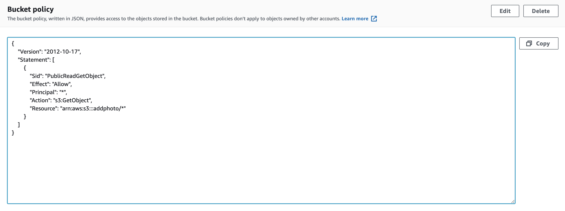
Create a public bucket
Add bucket policy so that every object in the bucket can be accessed

Slide 9
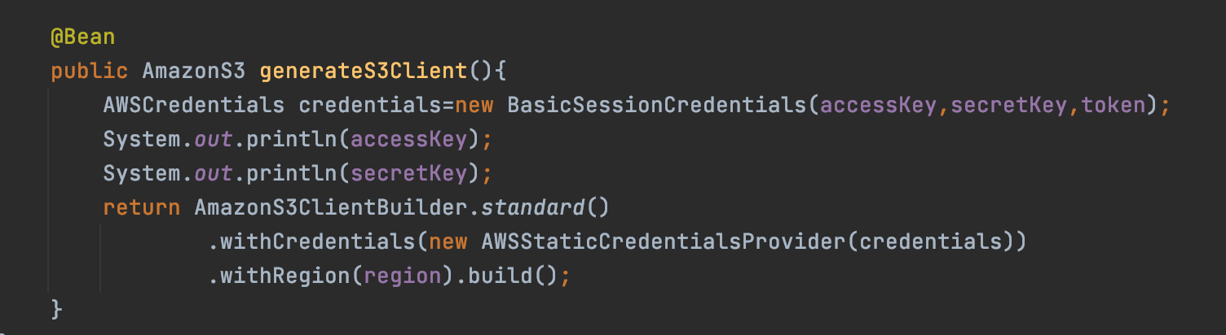
Configure S3 client
Use credential keys with region to connect to S3
Cause I am temporary user, I need a token to validate my credential keys

Slide 10
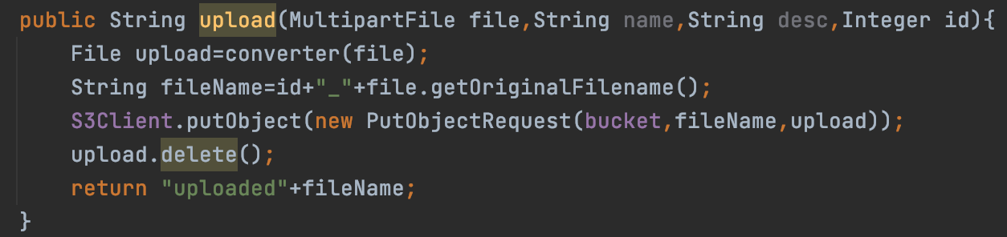
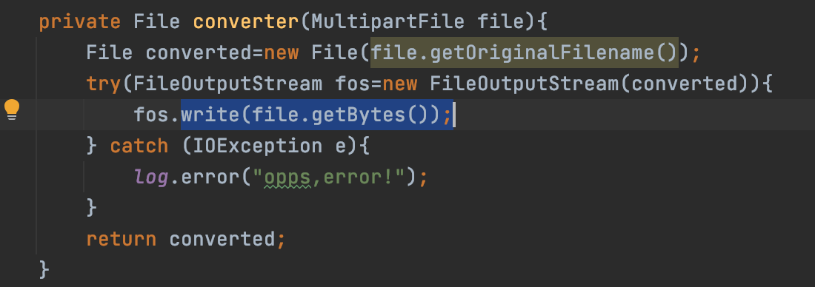
Send image to S3
Multipart file contains binary data and file name which can not be used to upload
Use helper function transform multipart file to file
Use put object request to put image to S3.
Delete the upload file once upload is completed.

Slide 11
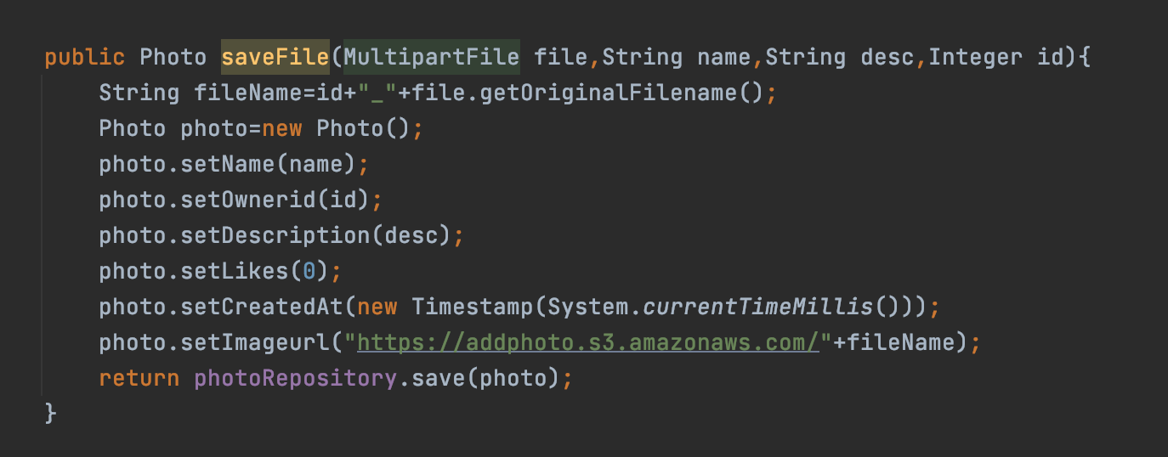
Save to database
Set data and a unique S3 URL as a photo object, save the photo into database.

Slide 12
Likes and comments
Likes table
Comments table

Slide 13
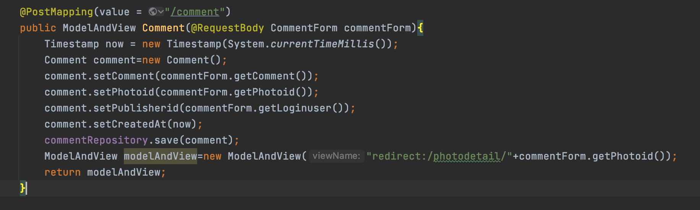
Comments table
Store comment, commented image id, publisher id

Slide 14
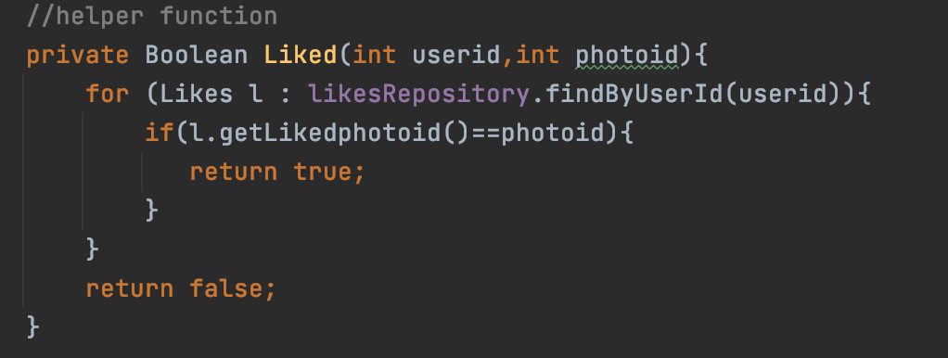
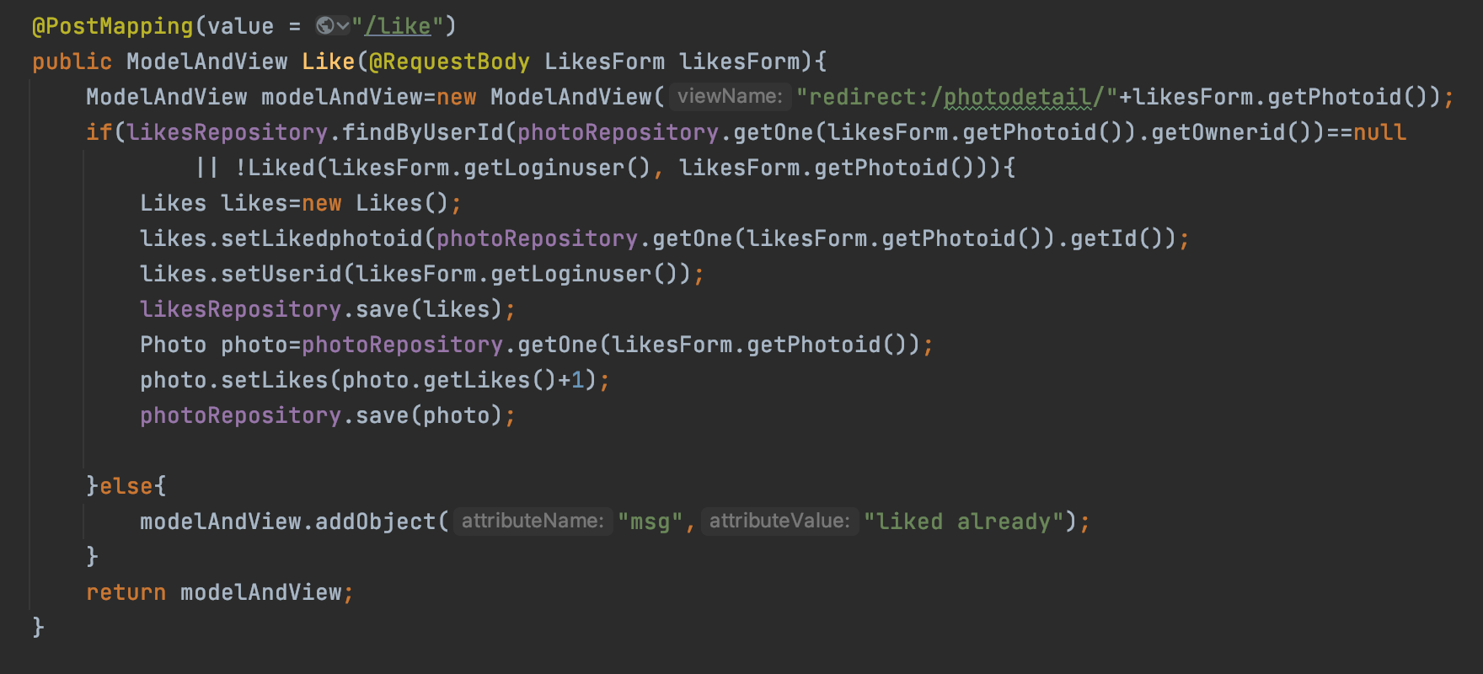
Likes table
Store like publisher id, liked image id
A user can only like one image once, a helper function is needed to check if current user has liked current image or not.

Slide 15
Amazon RDS
Create new public RDS database
Set security group
Configure properties file to connect to RDS database

Slide 16
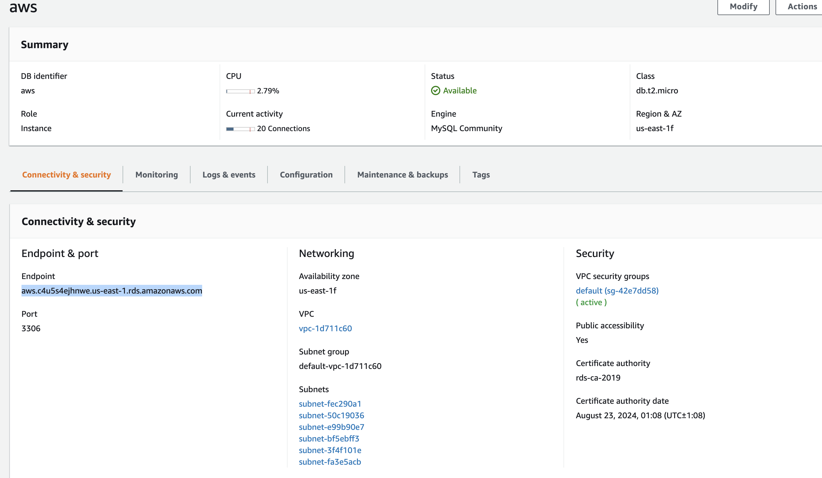
Create new public RDS database

Slide 17
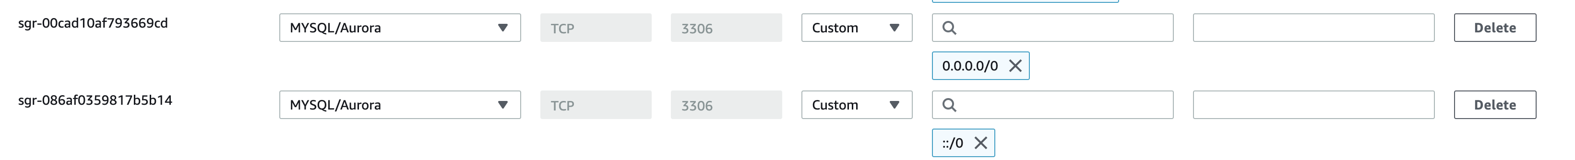
Set security group

Slide 18
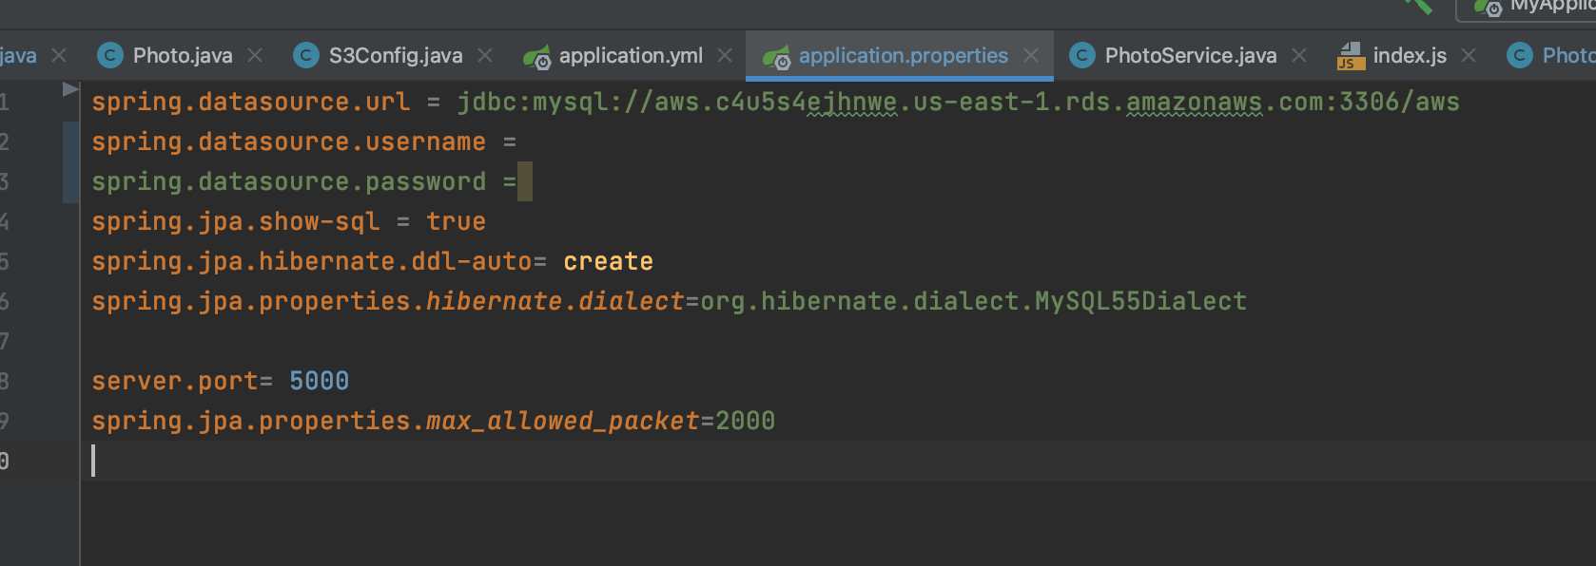
Configure properties file

